Slide 1


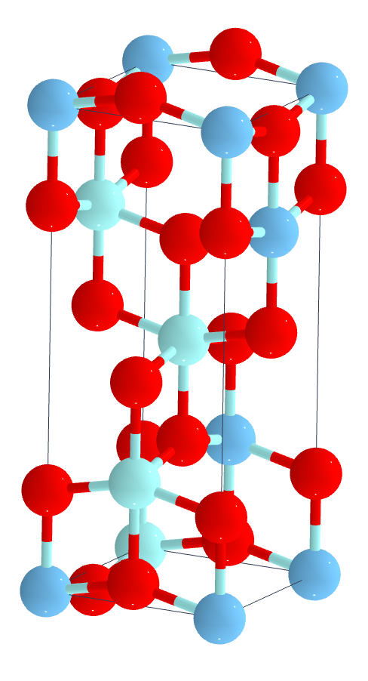
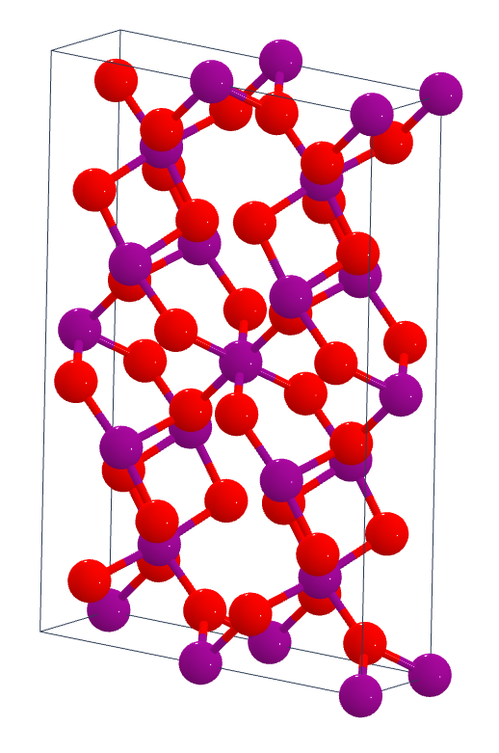
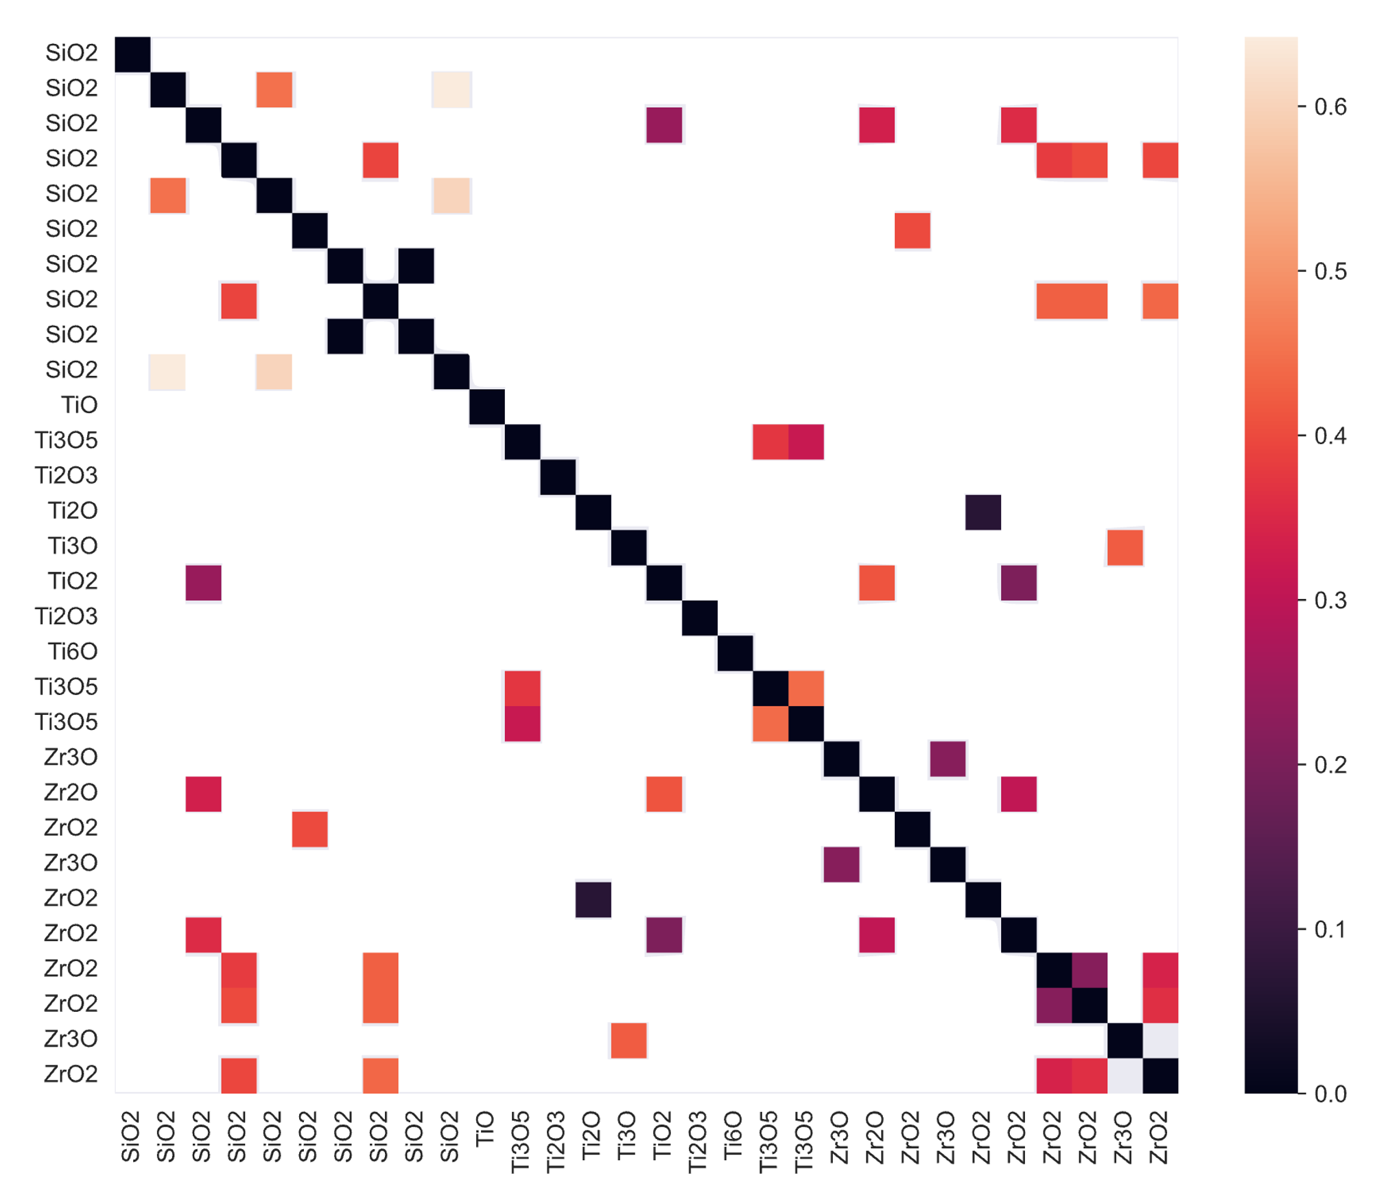
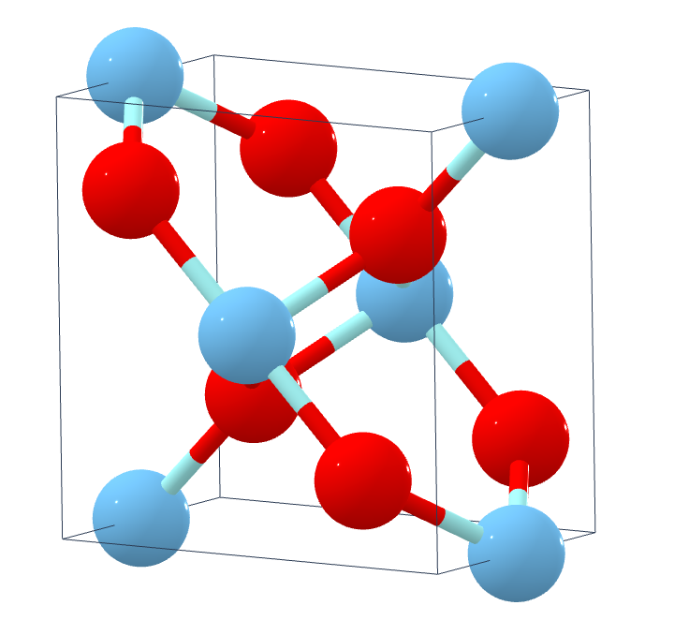
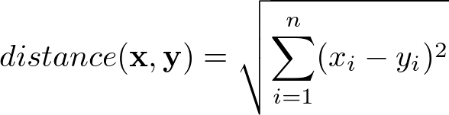
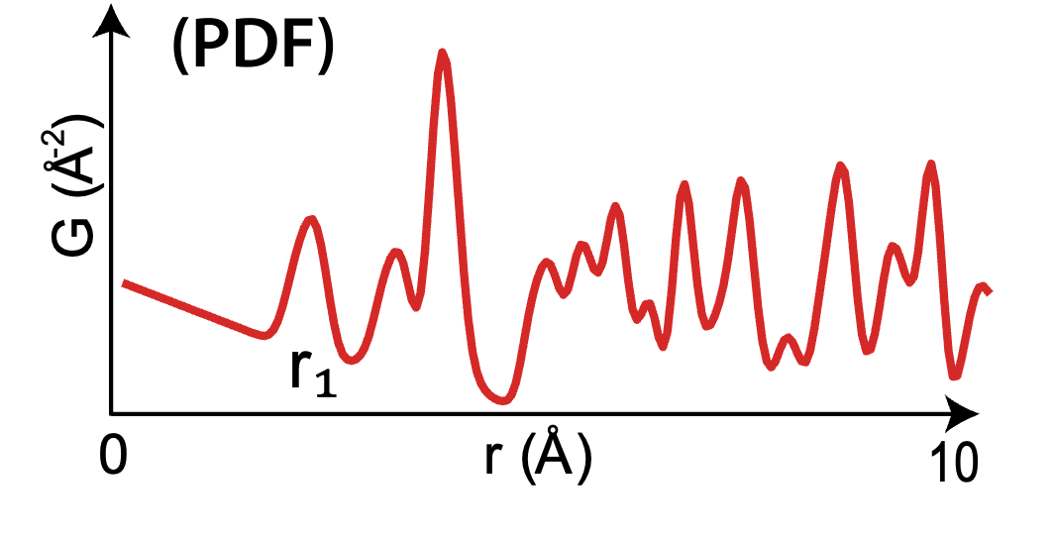
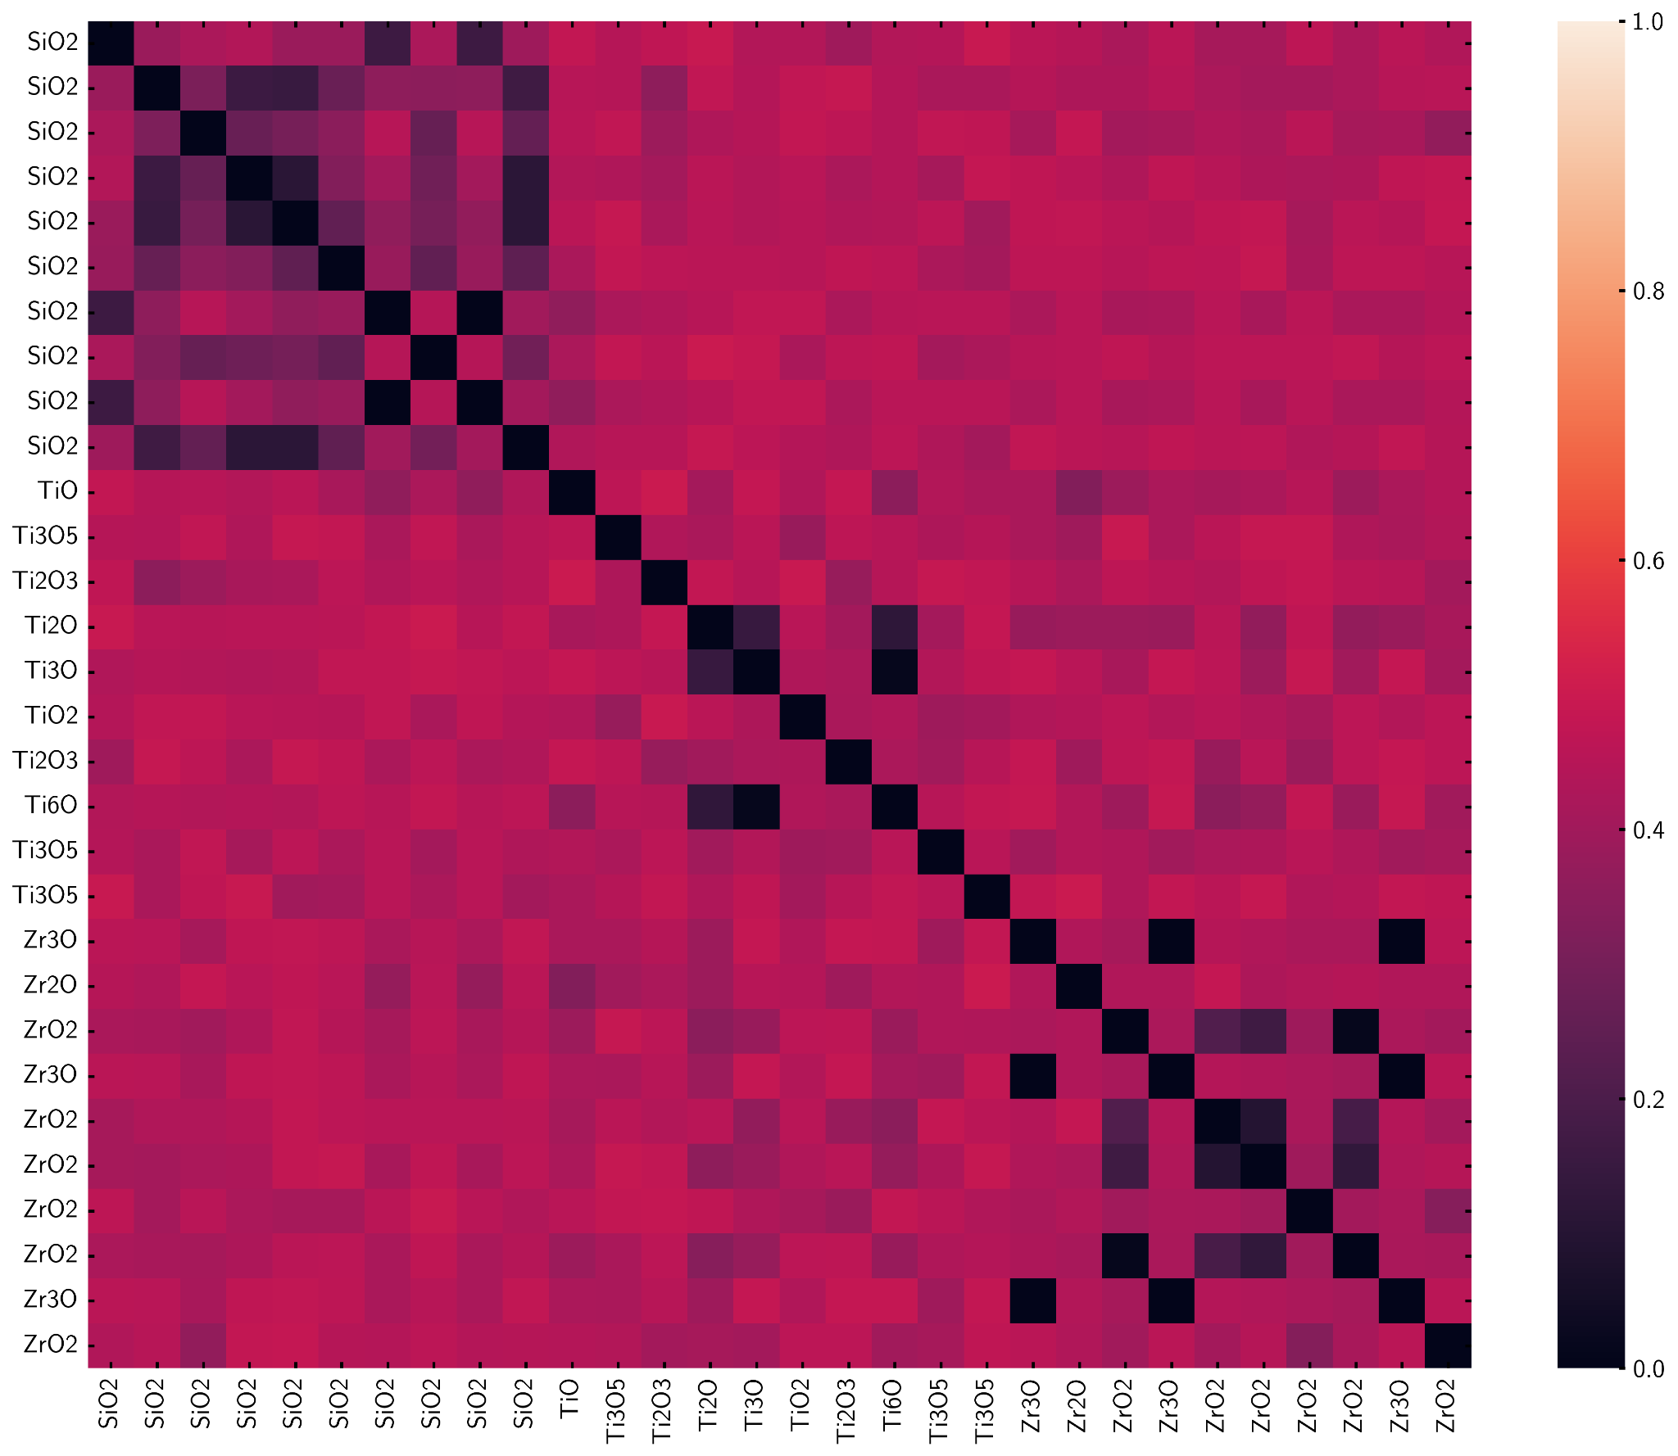
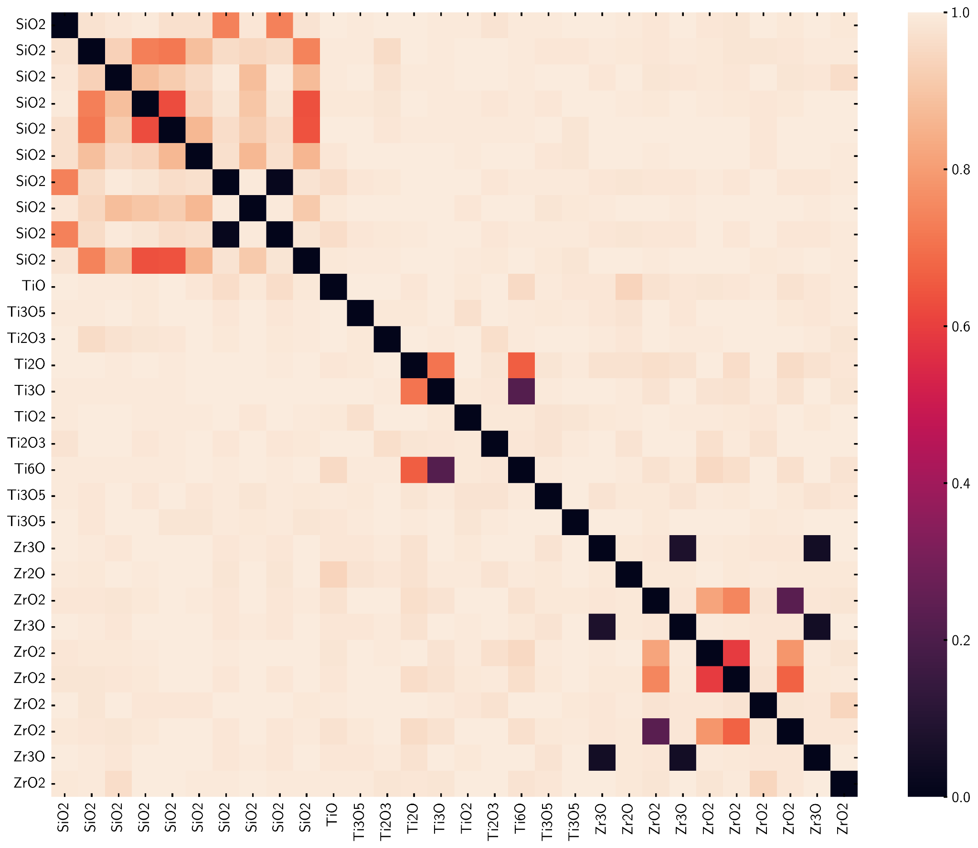
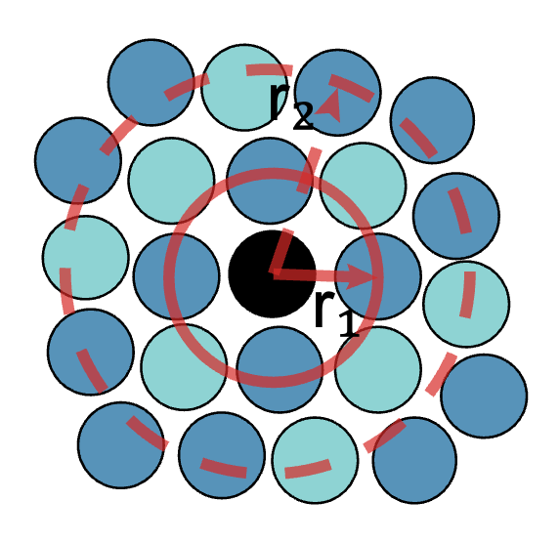
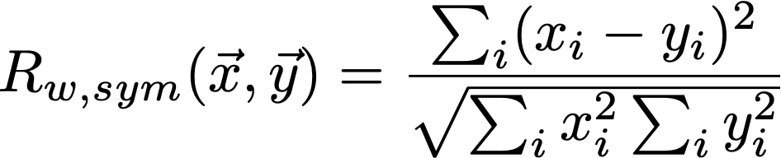
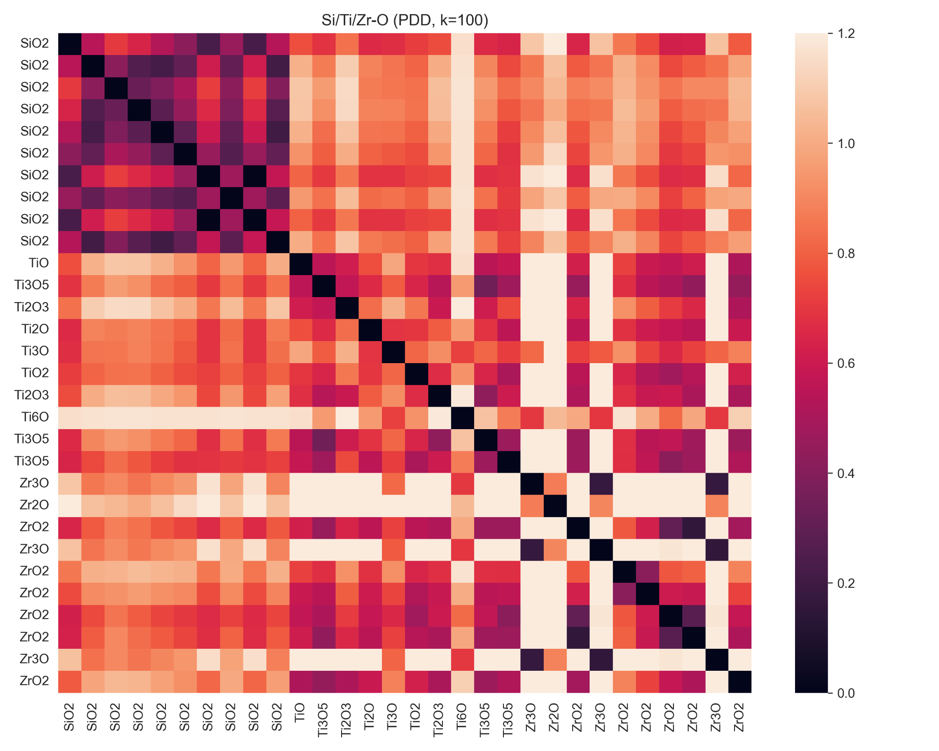
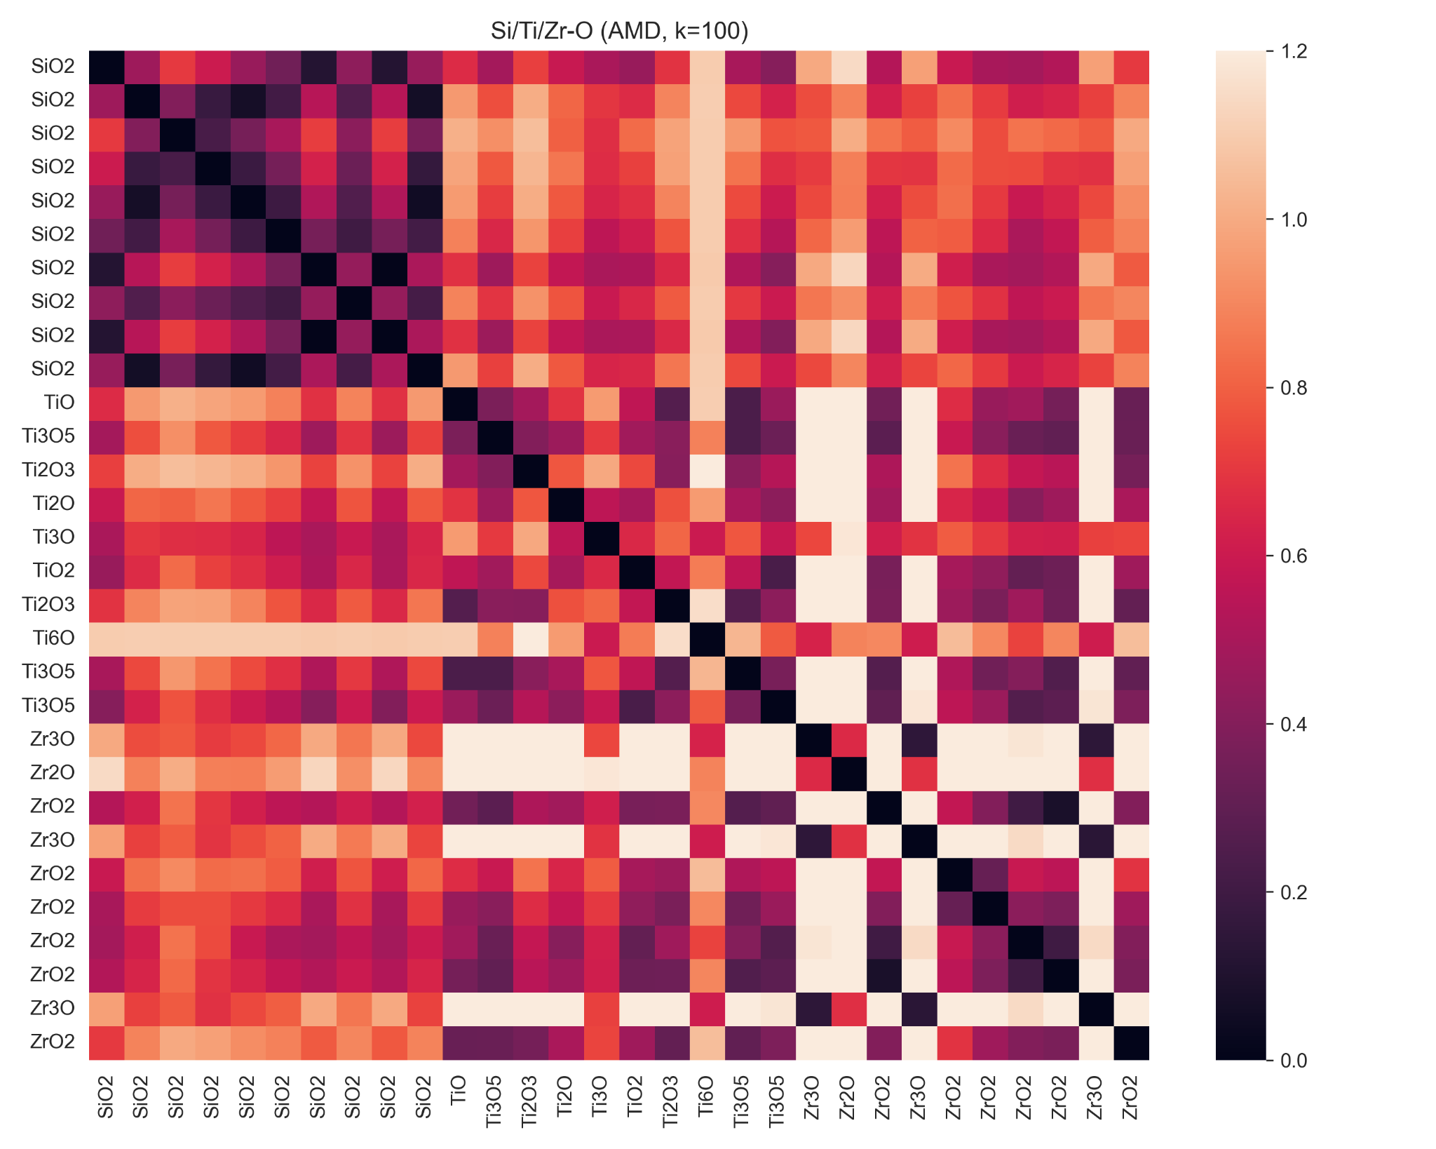
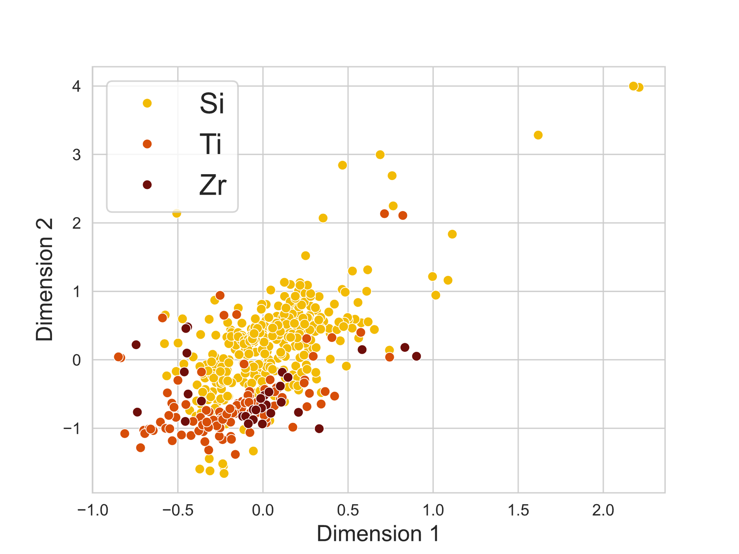

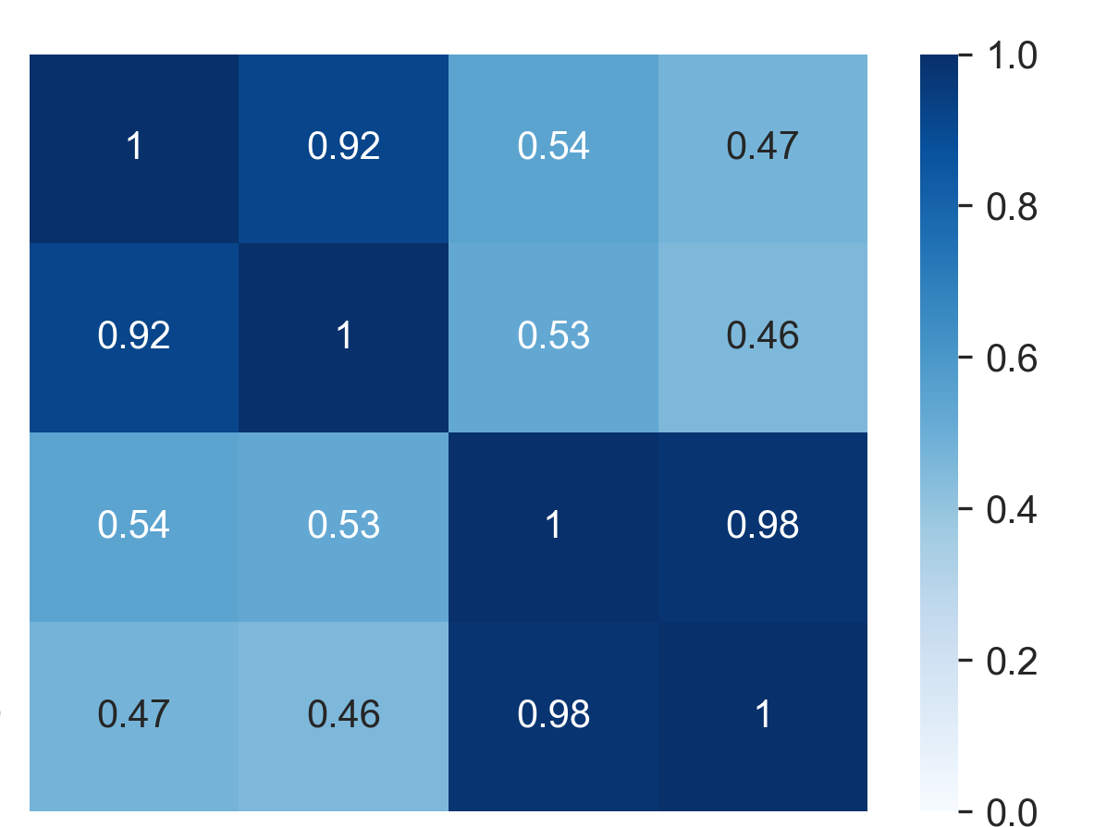
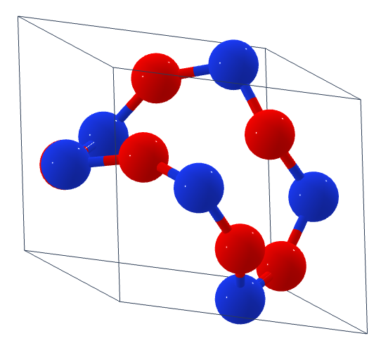
How to Tell Structures Apart: Data-Driven Analysis of Structural Similarity Measures
Tanaporn Na Narong*¹, Zoe N. Zachko*¹, Andrew Yang*¹, Steven B. Torrisi² & Simon J. L. Billinge¹
¹Department of Applied Physics and Applied Mathematics, Columbia University, NY 10027
²Toyota Research Institute, Los Altos, CA 94022
Which structures are the same/different? And how different are they?
Baseline: pymatgen.StructureMatcher module
RMS distances
Si
Ti
Zr
Pymatgen: open-source Python library for materials analysis [2]
StructureMatcher module compares structures based off their atomic coordinates.
Distance measure:
Root-mean-square distance between the atomic positions of two structures
Ignores atomic species, only accounts for atomic sites and lattice parameters
Permutes atomic sites to minimize RMS, account for rotations & symmetries
Si
Ti
Diagonal elements are zero: d_{ii} = 0
TiO₂ (rutile)
Zr
TiO₂ (anatase)
MnO₂ (rutile)
Pair Distribution Function (PDF): “histogram” of bond lengths in the structure, experimentally measurable from diffraction data.
Distance measures:
Pearson correlation coefficient (PCC)
Symmetrized R_{w}
*Pairs of PDFs are “morphed” before computing PCC and R_{w}. This accounts for differences in scale between structures, which affects R_{w}, PCC greatly.
(1 - PCC)/2
Symmetrized R_{w}
It depends... We can look at their compositions, atoms’ positions, bond lengths, etc.
What if I give you 2 million structures?
Problems
Millions of “new” materials have been predicted by AI (e.g. Google DeepMind [1]). How do we know they are truly different from existing structures?
How do we validate if two structures are the same? If they are different, how different are they?
Use case: compare ground truth vs AI/ML predicted structures
Pointwise Distance Distribution (PDD)
Matrix of interatomic distances in the structure (isometry invariant)
Each row of a PDD matrix lists k shortest distances (ascending order) from an atom in the unit cell to other atoms
Distance measure: Earth’s Mover Distance (EMD)
→ treat PDD matrix elements as “piles” of Earth
→ solve a linear programming problem to quantify
the minimum “mass transport work” needed to make
the two PDDs identical
Average Minimum Distance (AMD)
AMD is an average of PDD: vector of k average shortest distances
Distance measure: Chebyshev distance
Distance between PDDs (k=100)
Distance between AMDs (k=100)
Goal: develop a data-driven framework to systematically analyze and compare different structural similarity measures
Distances to neighbors
1 2 3 … k
1
2 1 1. 1.2 … 5
N
Atom in unit cell
…
2. Do different measures agree?
Compute correlations between the distance matrices
Analyze clusters of structures
AMD=
average of PDD rows
Average bond distances
Methods
1. Compute a distance matrix:
d_{ij} = d_{ji} = distance between i and j
0
 | 0 |  | d_{ji}
 |  | 0
 | d_{ij} |  | 0
 |  |  |  | 0
Correlations between measures
Summary & Outlook
Structures within the same chemical group (Si/Ti/Zr) show higher similarity than across different groups
Ti-O structures tend to be more similar to Zr-O than Si-O, but we need a larger sample size to statistically verify this trend
Similarity measures that are based on the same structural descriptors are highly correlated (PDF-PCC and PDF-R_{w} / PDD and AMD)
Future work: incorporate larger datasets, cluster analysis, and additional similarity measures
structure i
PDF-pcc
Scatterplot of structures based on an AMD-based distance matrix
Correlations with StructureMatcher
(only distances below threshold included)
PDF-R_{w}
PDF-pcc | 0.72
PDF-R_{w} | 0.83
PDD | 0.63
AMD | 0.55
structure j
PDD
References
Merchant, A., Batzner, S., Schoenholz, S. S., Aykol, M., Cheon, G., & Cubuk, E. D. (2023). Scaling deep learning for materials discovery. Nature, 624(7990), 80-85.
Ong, S. P., Richards, W. D., Jain, A., Hautier, G., Kocher, M., Cholia, S., ... & Ceder, G. (2013). Python Materials Genomics (pymatgen): A robust, open-source python library for materials analysis. Computational Materials Science, 68, 314-319.
Billinge, S. J. (2019). The rise of the X-ray atomic pair distribution function method: a series of fortunate events. Philosophical Transactions of the Royal Society A, 377(2147), 20180413.
Widdowson, D., & Kurlin, V. (2021). Pointwise distance distributions of periodic point sets. arXiv preprint arXiv:2108.04798.
Datasets (preliminary): oxides with
many polymorphs from Materials Project
Distances between structures are based on:
pymatgen.StructureMatcher (baseline)
Pair distribution function (PDF)
Pointwise distance distribution (PDD)
Average minimum distance (AMD)
Si
Ti
Zr
+
O
AMD
PDF-pcc
PDF-R_{w}
PDD
AMD

